Slide 1
Pt20Au80_AgBP1_hollow_shell_XA>XAP
2023-09-18

Slide 2
Input Parameters for DecomNano
Input Parameters (All) 34328 data
Input Parameters (Droped parameters with no answer) 34328 data
Parameter | Min | Max | Mean | Standard Deviation
dP | 2.8 | 2.8 | 2.8 | 0.0
dA | 2.9 | 2.9 | 2.9 | 0.0
fA | 0.8 | 0.8 | 0.8 | 0.0
nAA | 6.0 | 7.0 | 6.6 | 0.3
nPP | 9.2 | 10.6 | 9.6 | 0.4
nAP | 0.1 | 1.1 | 0.8 | 0.3
nPA | 0.3 | 1.9 | 0.7 | 0.4
DA | 8 | 24 | 13.2 | 2.7
DAP | 25 | 25 | 25.0 | 0.0
DP | 0 | 24 | 9.7 | 7.7
DAPh | 0 | 12 | 4.9 | 3.9
Parameter | Min | Max | Mean | Standard Deviation
dP | 2.8 | 2.8 | 2.8 | 0.0
dA | 2.9 | 2.9 | 2.9 | 0.0
fA | 0.8 | 0.8 | 0.8 | 0.0
nAA | 6.0 | 7.0 | 6.6 | 0.3
nPP | 9.2 | 10.6 | 9.6 | 0.4
nAP | 0.1 | 1.1 | 0.8 | 0.3
nPA | 0.3 | 1.9 | 0.7 | 0.4
DA | 8 | 24 | 13.2 | 2.7
DAP | 25 | 25 | 25.0 | 0.0
DP | 0 | 24 | 9.7 | 7.7
DAPh | 0 | 12 | 4.9 | 3.9

Slide 3
Ouput Parameters
Parameter | Min | Max | Mean | Standard Deviation
dP | 2.8 | 2.8 | 2.8 | 0.0
dA | 2.9 | 2.9 | 2.9 | 0.0
fA | 0.8 | 0.8 | 0.8 | 0.0
nAA | 6.0 | 7.0 | 6.6 | 0.3
nPP | 9.2 | 10.6 | 9.6 | 0.4
nAP | 0.1 | 1.1 | 0.8 | 0.3
nPA | 0.3 | 1.9 | 0.7 | 0.4
DA | 8 | 24 | 13.2 | 2.7
DAP | 25 | 25 | 25.0 | 0.0
DP | 0 | 24 | 9.7 | 7.7
DAPh | 0 | 12 | 4.9 | 3.9
nAM_AP | 1.2 | 12.0 | 5.5 | 1.5
nPM_AP | 8.6 | 12.0 | 10.8 | 0.7
nAA_AP | 0.0 | 7.5 | 2.7 | 1.5
nAP_AP | 0.6 | 11.0 | 2.8 | 1.1
nPA_AP | 0.3 | 3.3 | 0.9 | 0.5
nPP_AP | 7.4 | 11.7 | 10.0 | 0.5
XAP | 0.01 | 0.5 | 0.28 | 0.1
XA | 0.13 | 0.99 | 0.65 | 0.13
XP | 0.0 | 0.77 | 0.07 | 0.1
y | 0.06 | 0.57 | 0.24 | 0.1
dAP | 2.9 | 2.9 | 2.9 | 0.0
nMM_AP | 10.2 | 10.2 | 10.2 | 0.0
nAA_A | 7.5 | 10.1 | 8.8 | 0.5
nPP_P | 0.0 | 10.2 | 6.6 | 3.3
NA | 24.7 | 344.2 | 81.9 | 41.7
NP | 1.0 | 381.7 | 87.7 | 114.8
NAP | 391.6 | 391.6 | 391.6 | 0.0
XA*NA | 6.8 | 160.7 | 50.0 | 19.2
XP*NP | 0.0 | 268.0 | 12.7 | 29.1
XAP*NAP | 4.1 | 194.9 | 110.0 | 37.6
frac_XA*NA | 0.05 | 0.82 | 0.3 | 0.1
frac_XP*NP | 0.0 | 0.71 | 0.06 | 0.12
frac_XAP*NAP | 0.12 | 0.9 | 0.64 | 0.13
frac_Pt_P | 0.0 | 0.91 | 0.1 | 0.18
frac_Pt_PA | 0.09 | 1.0 | 0.9 | 0.18

Slide 4
Solution of DecomNano
Parameter | Min | Max | Mean | Standard Deviation
nAM_AP | 1.2 | 12.0 | 5.5 | 1.5
nPM_AP | 8.6 | 12.0 | 10.8 | 0.7
nAA_AP | 0.0 | 7.5 | 2.7 | 1.5
nAP_AP | 0.6 | 11.0 | 2.8 | 1.1
nPA_AP | 0.3 | 3.3 | 0.9 | 0.5
nPP_AP | 7.4 | 11.7 | 10.0 | 0.5
XAP | 0.01 | 0.5 | 0.28 | 0.1
XA | 0.13 | 0.99 | 0.65 | 0.13
XP | 0.0 | 0.77 | 0.07 | 0.1
y | 0.06 | 0.57 | 0.24 | 0.1

Slide 5
Other Parameters Calculated in the DecomNano
Parameter | Min | Max | Mean | Standard Deviation
dAP | 2.9 | 2.9 | 2.9 | 0.0
nMM_AP | 10.2 | 10.2 | 10.2 | 0.0
nAA_A | 7.5 | 10.1 | 8.8 | 0.5
nPP_P | 0.0 | 10.2 | 6.6 | 3.3
NA | 24.7 | 344.2 | 81.9 | 41.7
NP | 1.0 | 381.7 | 87.7 | 114.8
NAP | 391.6 | 391.6 | 391.6 | 0.0

Slide 6
Extracted Parameter Related to Hetereogeneity
Parameter | Min | Max | Mean | Standard Deviation
XA*NA | 6.8 | 160.7 | 50.0 | 19.2
XP*NP | 0.0 | 268.0 | 12.7 | 29.1
XAP*NAP | 4.1 | 194.9 | 110.0 | 37.6
y | 0.06 | 0.57 | 0.24 | 0.1
nAM_AP | 1.2 | 12.0 | 5.5 | 1.5
nPM_AP | 8.6 | 12.0 | 10.8 | 0.7

Slide 7
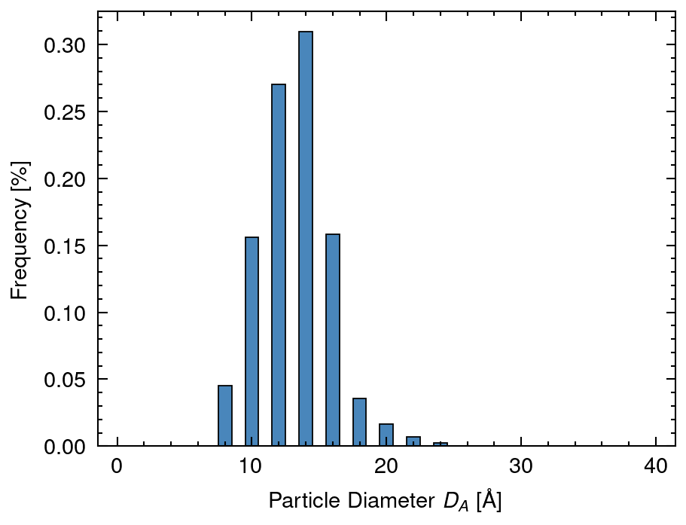
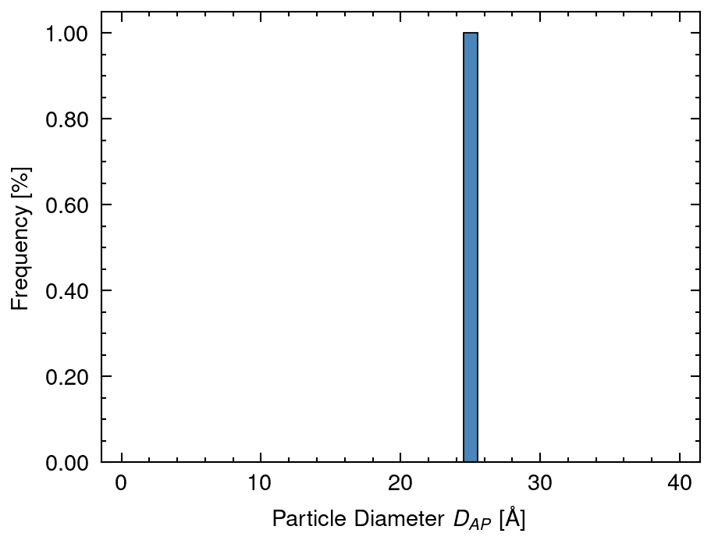
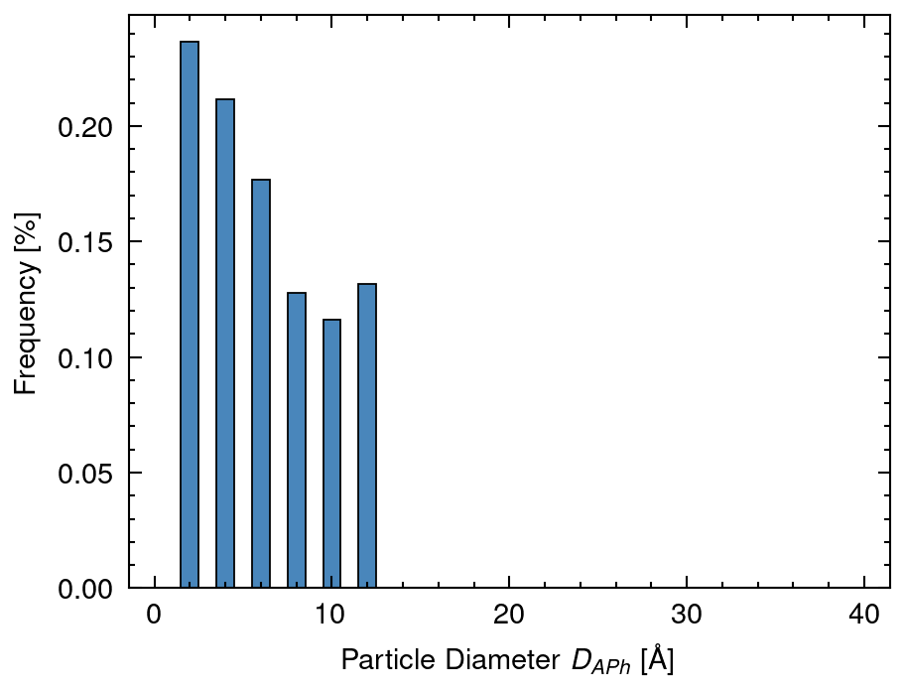
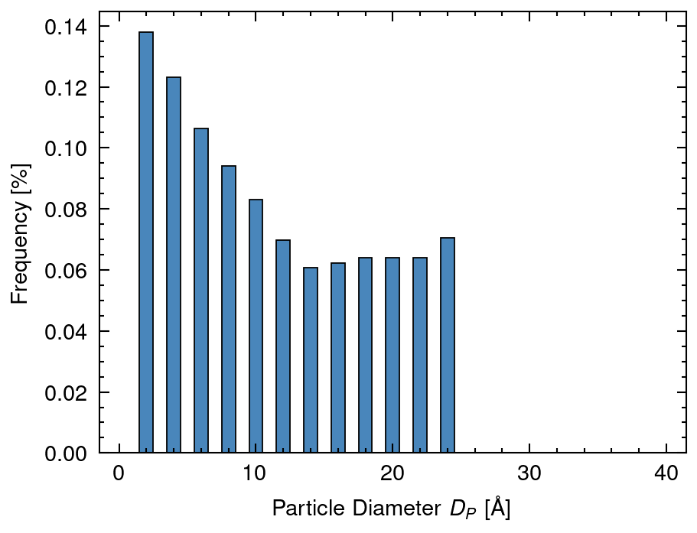
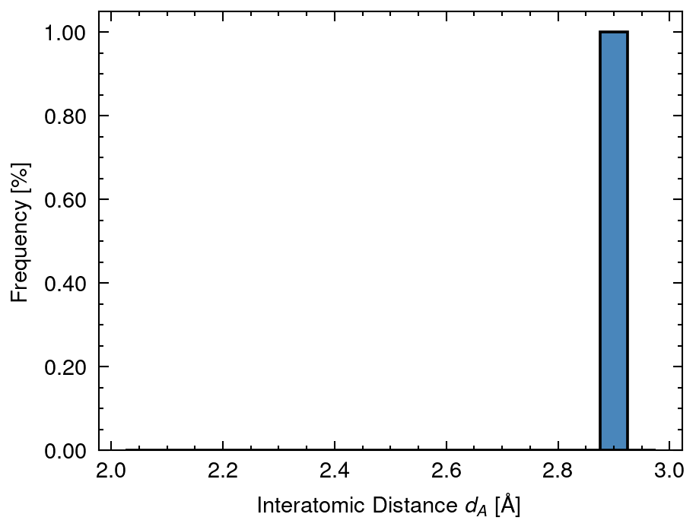
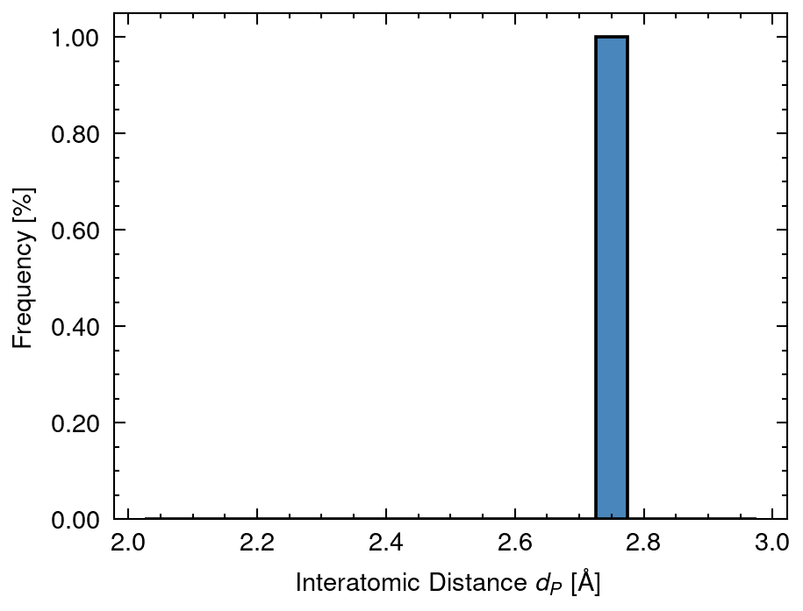
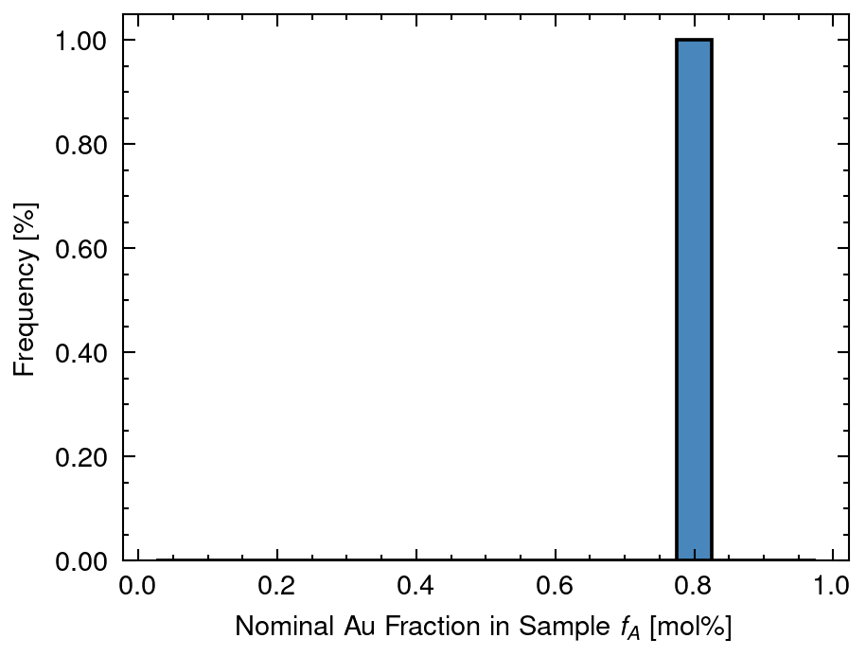
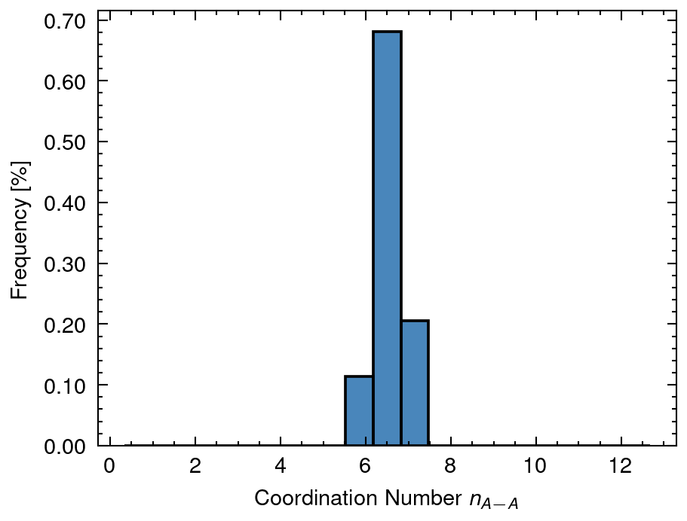
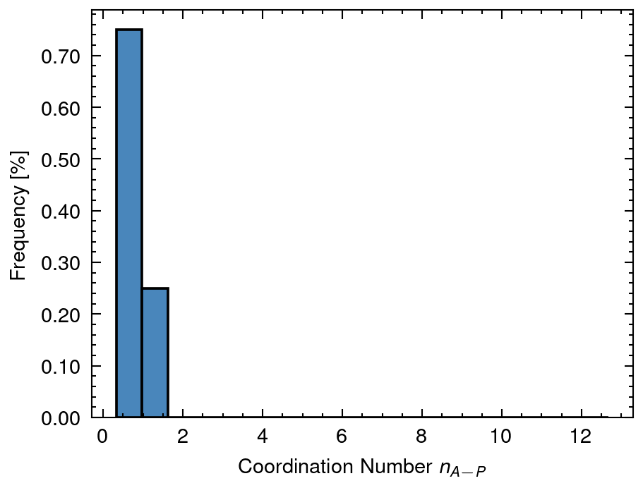
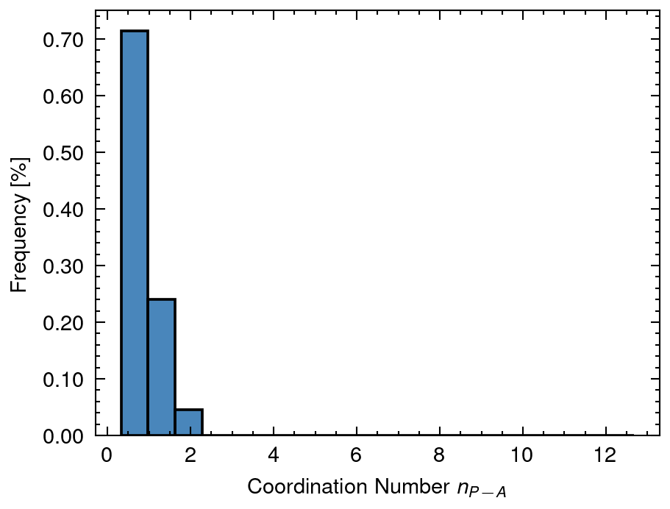
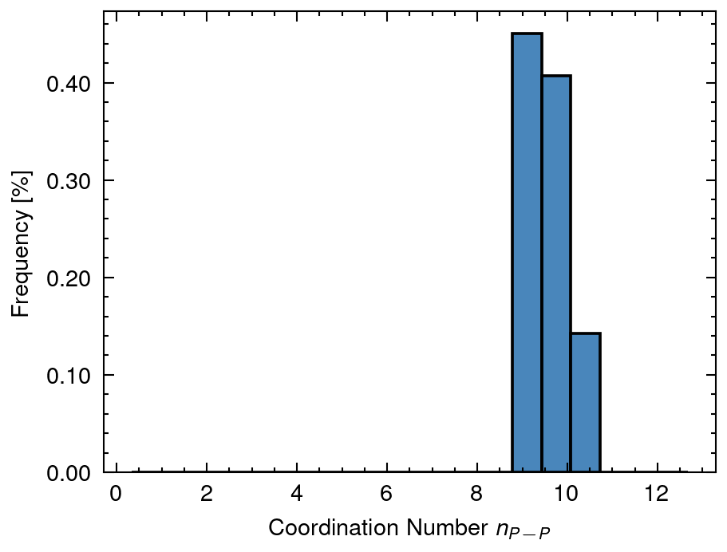
1 Distribution of input data
DA mean: 13.2 sd:2.65
DAP mean: 25.0 sd:0.0
DAPh mean: 4.91 sd:3.93
DP mean: 9.73 sd:7.66
dA mean: 2.88 sd:0.0
dP mean: 2.77 sd:0.0
fA mean: 0.8 sd:0.0
nAA mean: 6.57 sd:0.33
nAP mean: 0.77 sd:0.25
nPA mean: 0.69 sd:0.39
nPP mean: 9.64 sd:0.39

Slide 8
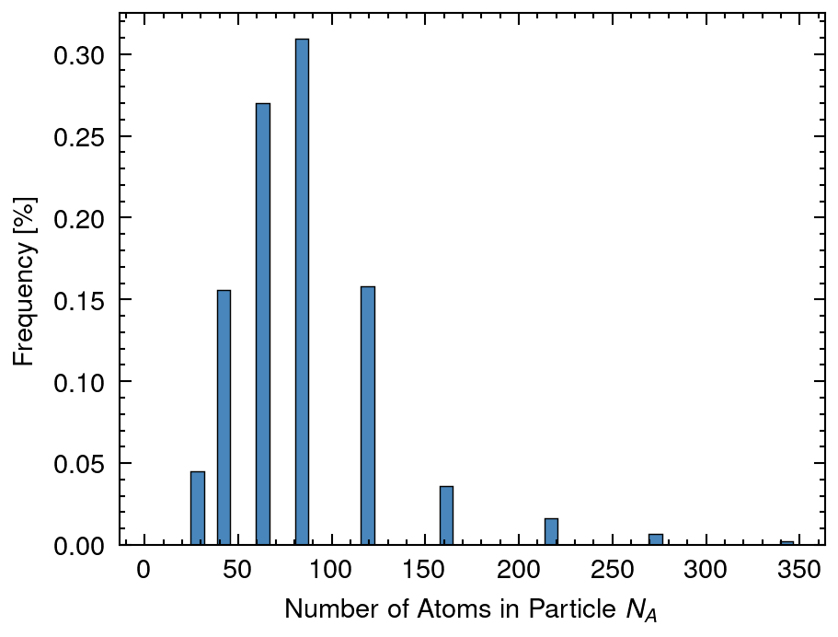
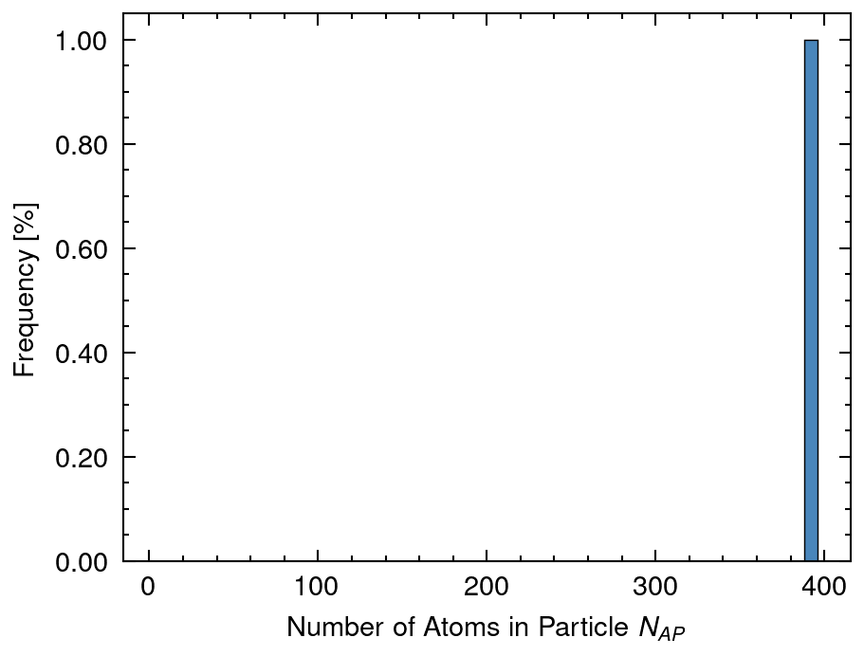
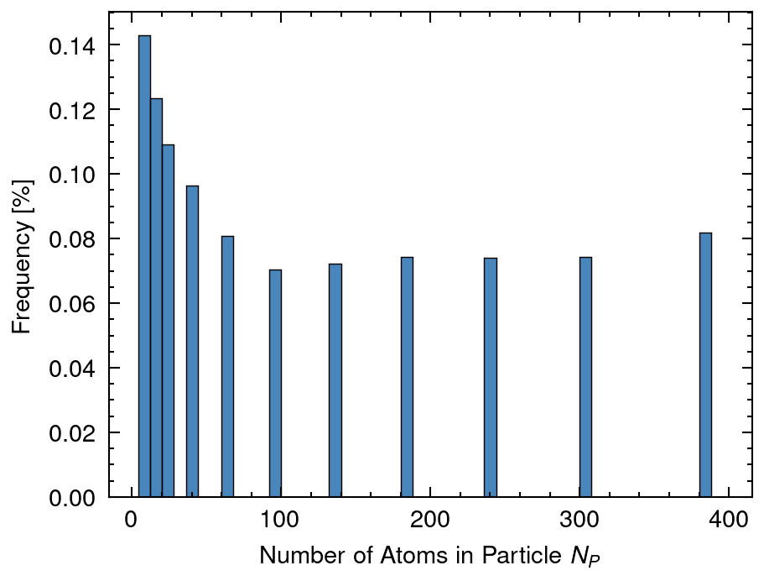
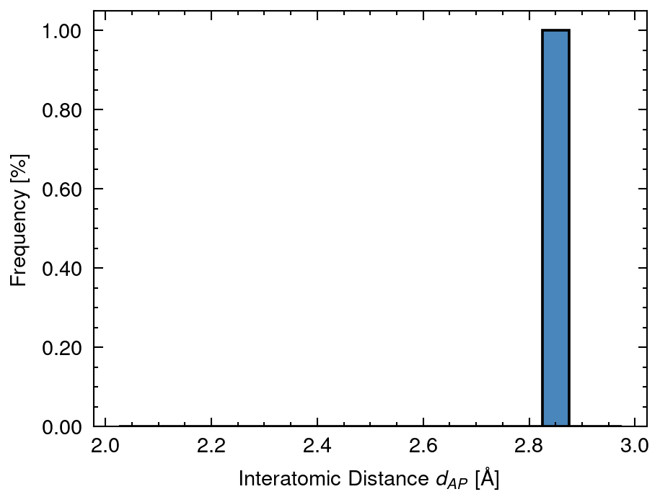
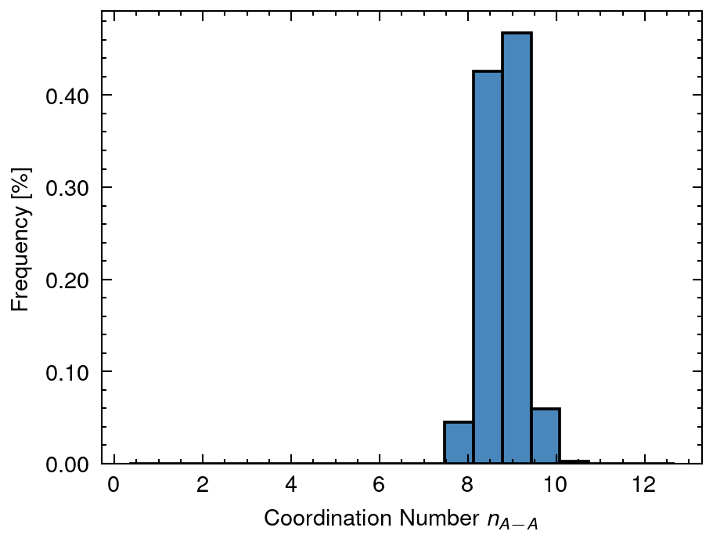
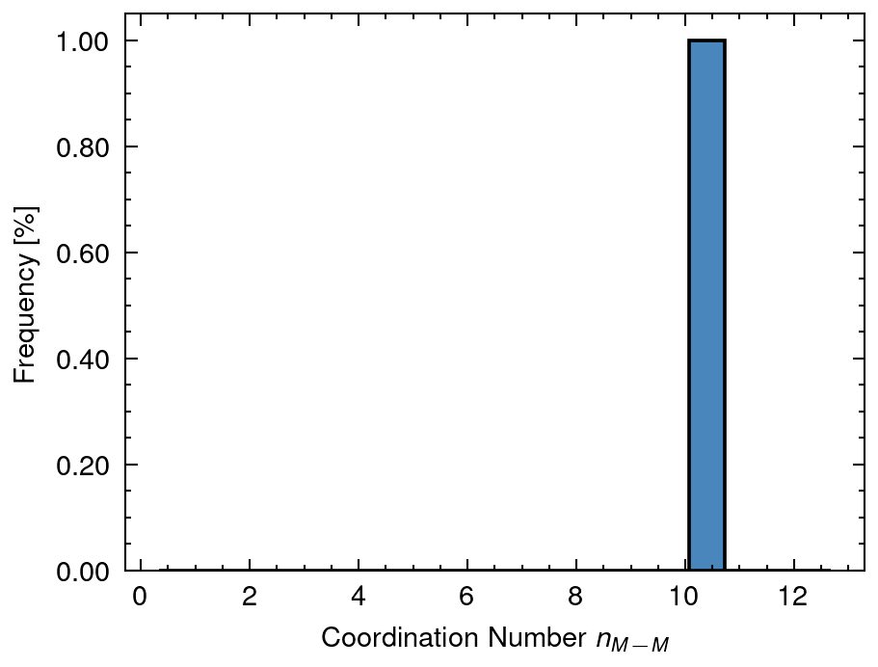
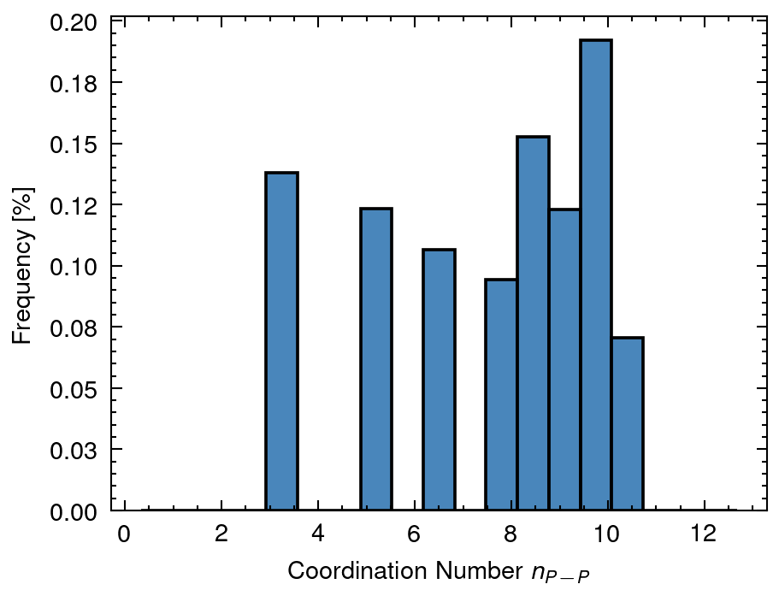
2 Distribution of calculated data
NA mean: 81.91 sd:41.73
NAP mean: 391.57 sd:0.0
NP mean: 87.69 sd:114.85
dAP mean: 2.86 sd:0.0
nAA_A mean: 8.78 sd:0.51
nMM_AP mean: 10.17 sd:0.0
nPP_P mean: 6.6 sd:3.3

Slide 9
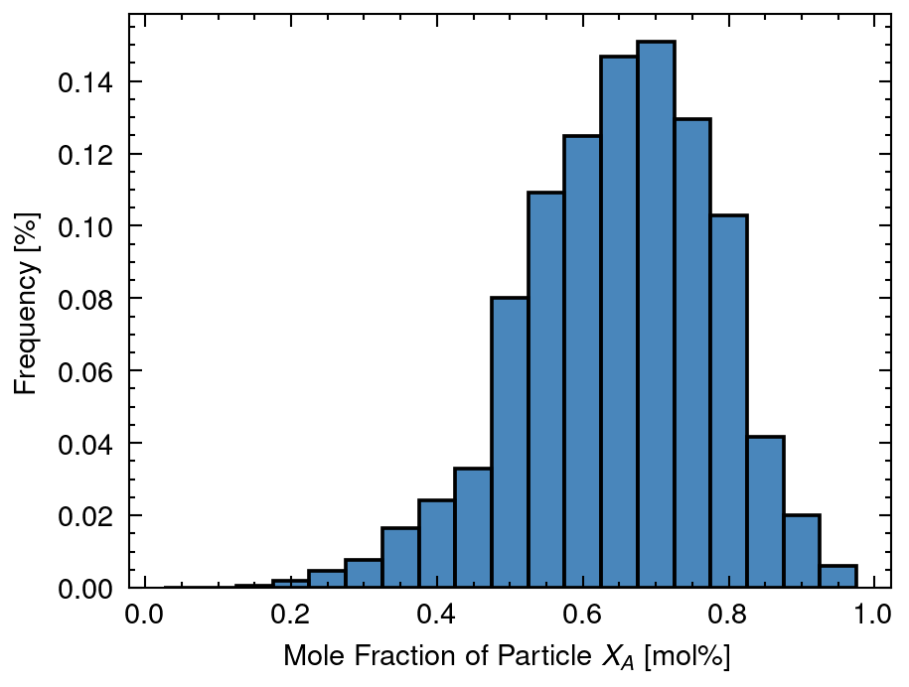
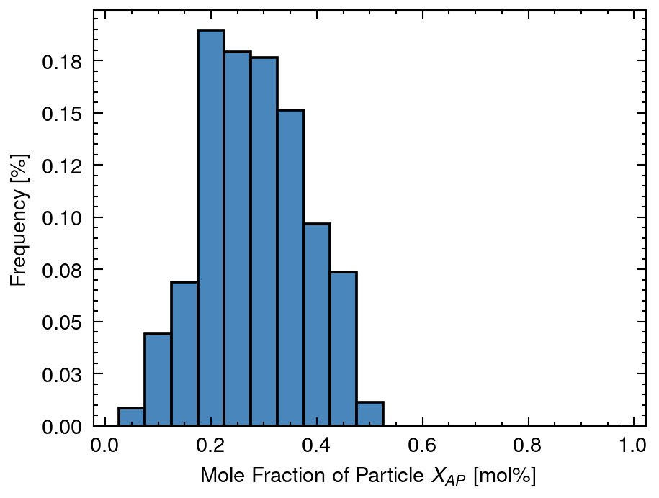
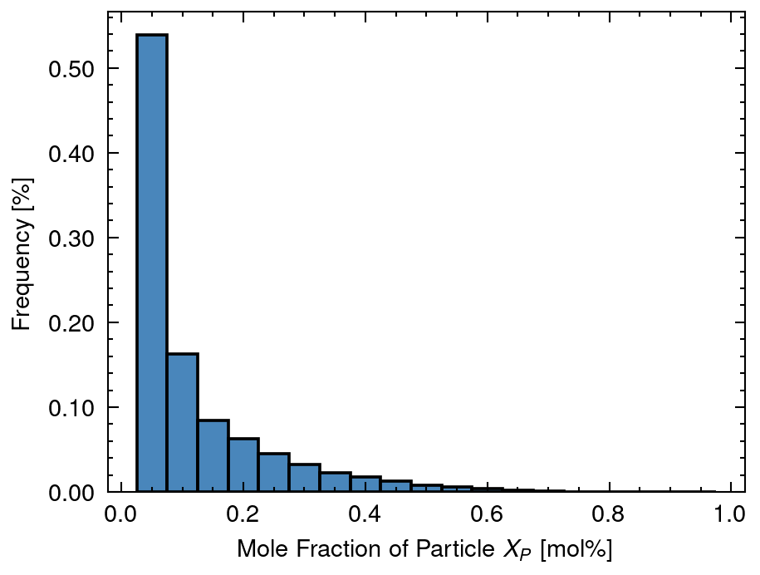
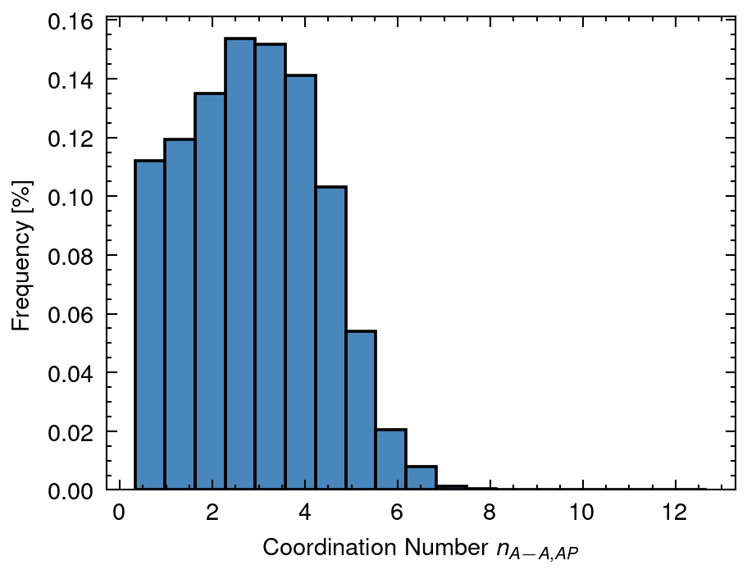
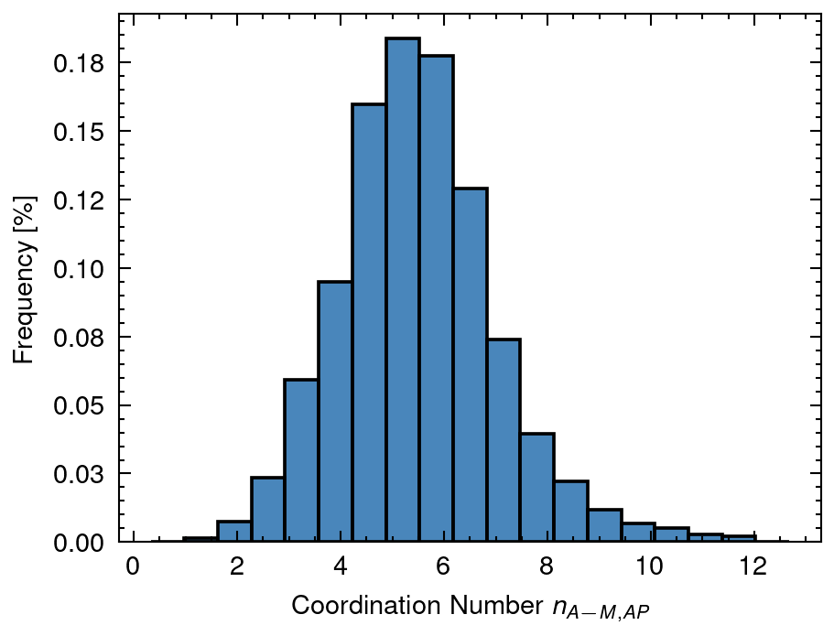
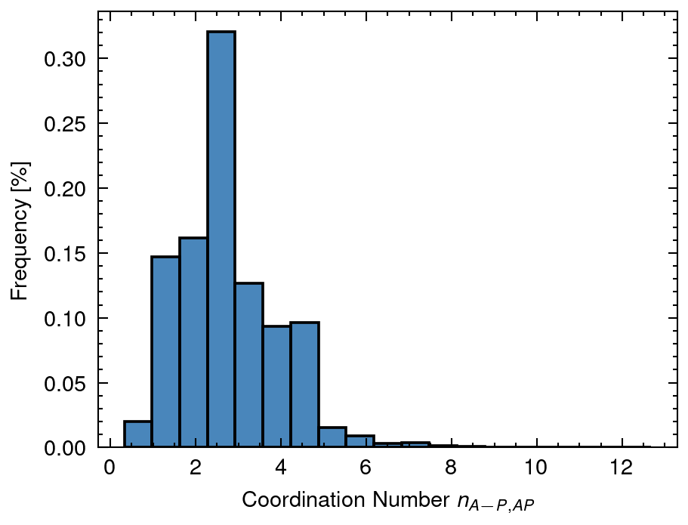
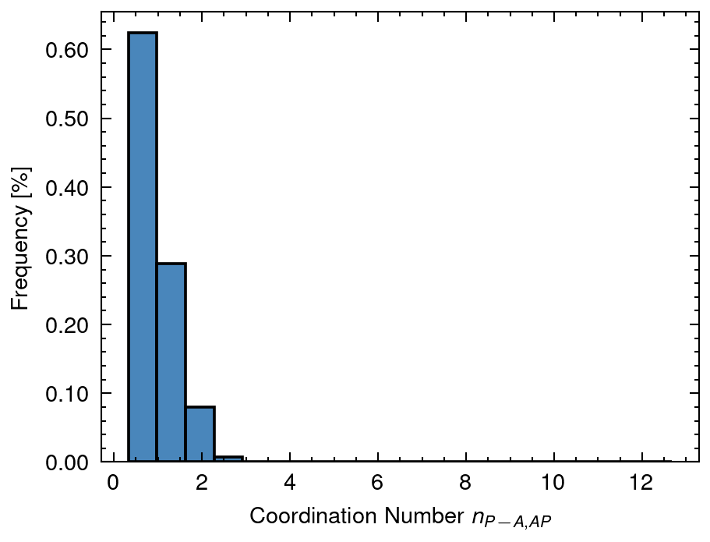
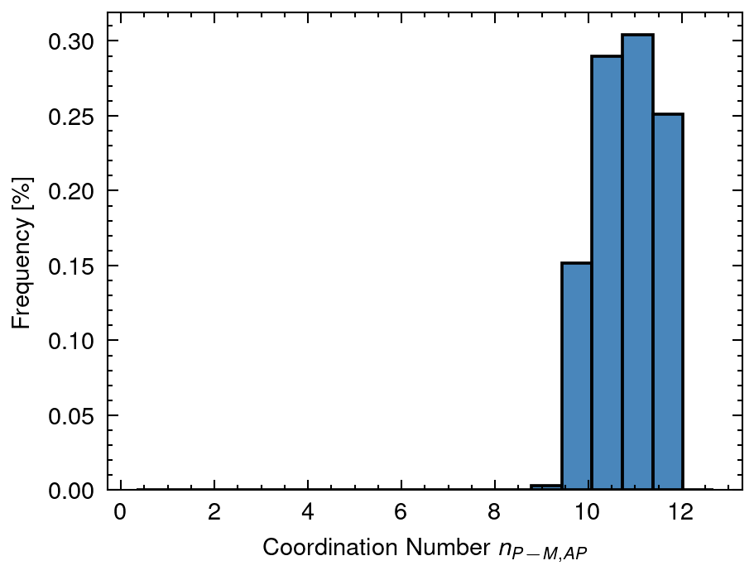
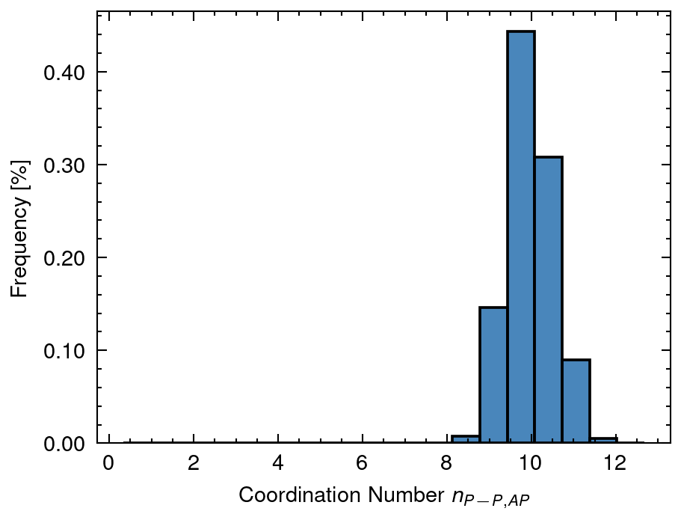
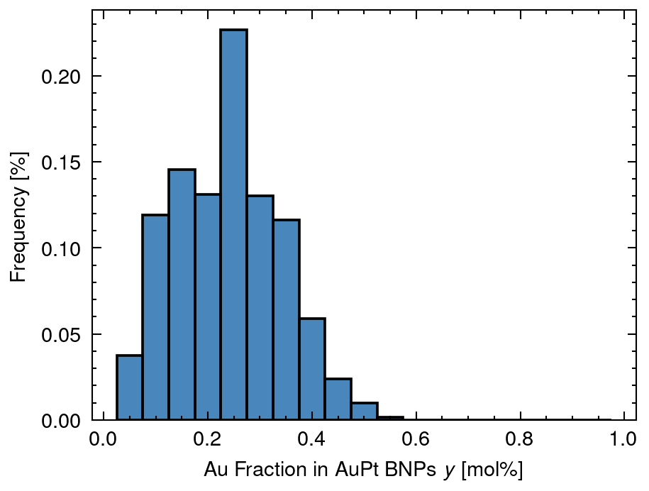
3 Distribution of solved data
XA mean: 0.65 sd:0.13
XAP mean: 0.28 sd:0.1
XP mean: 0.07 sd:0.1
nAA_AP mean: 2.74 sd:1.5
nAM_AP mean: 5.5 sd:1.52
nAP_AP mean: 2.76 sd:1.13
nPA_AP mean: 0.85 sd:0.47
nPM_AP mean: 10.83 sd:0.66
nPP_AP mean: 9.98 sd:0.53
y mean: 0.24 sd:0.1

Slide 10
4 Distribution of n (Overall Cordination Number)
nAA_A mean: 8.78 sd:0.51
nMM_AP mean: 10.17 sd:0.0
nPP_P mean: 6.6 sd:3.3

Slide 11
5 Distribution of X (Fraction of Nanoparticle)
XA mean: 0.65 sd:0.13
XAP mean: 0.28 sd:0.1
XP mean: 0.07 sd:0.1

Slide 12
6 Distribution of y (Fraction of Au in Nanoparticle)
y mean: 0.24 sd:0.1

Slide 13
7 Distribution of D (Diameter of Nanoparticle)
DA mean: 13.2 sd:2.65
DAP mean: 25.0 sd:0.0
DAPh mean: 4.91 sd:3.93
DP mean: 9.73 sd:7.66

Slide 14
8 Distribution of n (Coordination Number of Nanoparticle)
nAA_AP mean: 2.74 sd:1.5
nAM_AP mean: 5.5 sd:1.52
nAP_AP mean: 2.76 sd:1.13
nPA_AP mean: 0.85 sd:0.47
nPM_AP mean: 10.83 sd:0.66
nPP_AP mean: 9.98 sd:0.53

